Slide 1
Schola Europaea
Rationalization of calculation of salaries of seconded staff
Board of Governors April 2020

Slide 2
Remuneration Art. 49
The differential adjustment (AD) is calculated in two steps:
  1°/ interim calculation during the course of the year on the basis of the national tax withheld on the national salary slips;
European Remuneration
National Remuneration
Basic salary 3.704,38
Household allowance 250,10
Dep. child allowance 769,20
Health Insurance -40,75
Accident insurance -3,70
Temporary contribution -37,43
Europeen Tax ^{(*)} - 131,01
Salary (Gross Pay - Social contrib.) 2.883,70
National tax ^{(*)} - 672,06
2.211,64
Total = 4.510,79
Total = 4.510,79
Seconded Staff Remuneration
= 2.299,15
(*) Including an interim differential adjustment of 541,05
^{(672,06-131,01)}
2.299,15
This national tax is provisional!
2

Slide 3
1. Interim calculation
The interim salary calculation, is done monthly and:
Depends on systematic monthly transmission of national salary slips from national administrations (Article 49.2)
  →18 out of 28 Member States comply and 4 out of 28 partially comply
Seconded staff also has the obligation to provide all documentation regarding rights, and updates (Article 19)
Despite these, Schools accountants often do not receive documents and have to search, wasting valuable time
3

Slide 4
Proposed Legal modification (Art 49)
Objectives: to rationalize the process by:
1. Clarifying the responsibility of providing the national salary slips and placing it exclusively on the seconded staff :
2. Calculation once a year and adjusting when necessary.
Transmission once a year: salary slips applicable to August, and
after modifications to the national salary slip
Precautionary measures :
    Non-transmission of the salary slip applicable for the month of August
  → After 3 months : National tax at zero
  → After 6 months : suspension of payment of the European supplement
  → Article 75
    Non-transmission of any modification
→ Retroactive correction
→ Article 75
4

Slide 5
Second step: Differential Allowance
Current situation after definite calculation:
  Reimbursement to the European Schools = 70%
  Repayment to the Seconded staff = 30%
5

Slide 6
Second step: Differential Allowance
Frustration for 70% of the seconded staff members and subsequent lack of compliance
An advance on the EU budget for an amount of around 1,2 mio Euro per year
Administrative burden on schools to avoid financial loss.
  Many reminders to the seconded staff
  Withholding amounts from severance grants
  When they leave the system, letters and reminders
  Contacting lawyers
  Bringing files to Administrative Boards
  Administrative appeals and Complaints Board
6

Slide 7
Scenarios considered
Investigation of three scenarios by working group to limit the financial loss for the system as well as the loss of monthly net salary of the seconded staff
OBJECTIVE = KEEP ATTRACTIVNESS
National Tax at zero: put the interim National Tax at zero with a Tax advance
Lump-sum tax : put a lump-sum amount as interim National Tax
Proportional tax : put a proportional amount of 80% as interim National Tax
7

Slide 8

Scenario 1
National tax at 0
Taking into account of the National tax only at the time of submission of the tax document, then deferring a part of the payment.
➔ In practice : EU net without National tax during the current year
 | Current position | Proposition
Income year
Year of tax documents | → Financial Regularization = - 5.964,72 | Financial Regularization = + 2.100
TOTAL | = 21.625,08 (27.589,80 -5.964,72) | = 21.625,08 (19.525,08 + 2.100)
Seconded Staff Remuneration
2.299,15 x 12
= 27.589,80
Seconded Staff Remuneration
1.627,09 x 12
= 19.525,08
No financial impact for the seconded staff (only timing difference)
8

Slide 9

Alternative 1
National tax at 0
The following table summarizes the impact on the NET EU salary in the case the national tax is set at zero
Impact on attractiveness (loss of monthly net salary)
9

Slide 10
Scenario 2
Lump-sum Interim National Tax
A lump-sum amount (average national tax) is put as interim National Tax.
Creates huge imbalances due to non-harmonisation of taxation in Europe
Does not rectify overall % of negative differential allowance
10

Slide 11
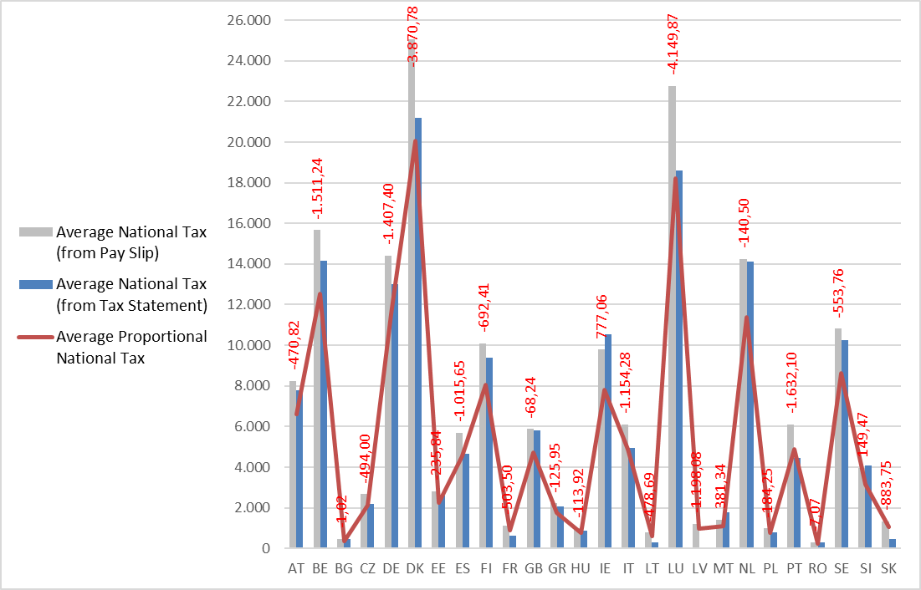
Scenario 3
Proportional Interim Tax
The interim National Tax is set at 80% of national tax during the year.
This proportionality respects the different tax legislation.
11

Slide 12
Alternative 3
Proportional Interim Tax
The following table summarizes the impact on the NET EU salary in the case a proportional amount is put as interim National Tax (Alternative 3)
Net with Proportional Tax | % | Total number of files | New staff | Old Staff | Monthly average loss | Nationality
<0 | 0,66% | 3 | 3 | 0 | 431 | LU, DE
0 - 12.000 | 2,63% | 12 | 12 | 0 | 203 | BE, DE, DK, IE
12.001 - 25.000 | 12,47% | 57 | 55 | 2 | 213 | AT, BE, CZ, DE, DK, ES, FI, FR, GB, IE, IT, NL
25.001 - 50.000 | 38,51% | 176 | 144 | 32 | 152 | AT, BE, DE, DK, EE, ES, FI, FR, GB, HU, IE, IT, LU, MT, NL, PL, PT, SE
50.001 - 75.000 | 33,04% | 151 | 72 | 79 | 112 | AT, BE, BG, CZ, DE, DK, EE, ES, FI, FR, GB, GR, HU, IE, IT, LT, NL, PL, PT, RO, SE, SI, SK
75.001 - 100.000 | 11,38% | 52 | 16 | 36 | 77 | AT, BE, CZ, DE, ES, FR, GB, GR, HU, IT, LT, LV, MT, PL, PT, SK
> 100.000 | 1,31% | 6 | 0 | 6 | 67 | CZ, GB, GR, IT, LT, PT
 | 100,00% | 457 | 302 | 155
LOW RANGE
MIDDLE RANGE
HIGH RANGE
12

Slide 13
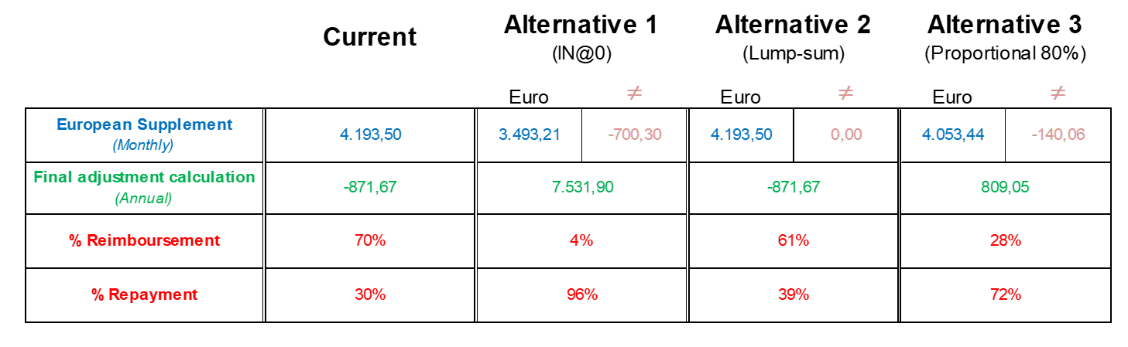
Overview of scenarios
13

Slide 14
Proposed
Legal modification
Scenario 3: Proportional Interim Tax
Interim calculation of European complement by taking 80% of national tax in article 49.2 c) of Regulation for Seconded Staff
Accompanying measures discussed at the Budget Committee
Improved information to seconded staff about rights and obligations
Shorter timeframe for final calculation
Review after two years
Entry into force September 2020
14

Slide 15
Thank you very much

Slide 16
Alternative 2
Lump-sum Interim National Tax
The following table summarizes the impact on the NET EU salary in the case a lump-sum amount is put as interim National Tax
50%
16

