Slide 1
European dimension and civic key competence in the E.S. CURRICULUM
Proposal of the spanish presidency
BOARD OF GOVERNORS
15-17 APRIL 2020

Slide 2
the meaning of ‘being european’ in the european schools curriculum
Our system plays an essential role in:
strengthening European identity in our students
providing them with
a better understanding of what it means to be European
a sense of belonging to the European project, so that they can fully embrace the motto ‘UNITED IN DIVERSITY’

Slide 3
THE TREATY ON EUROPEAN UNION
“The Union is founded on the values of respect for human dignity, freedom, democracy, equality, the rule of law and respect for human rights, including the rights of persons belonging to minorities. These values are common to the member states in a society in which pluralism, non-discrimination, tolerance, justice, solidarity and equality between women and men prevail.”
“The Union's aim is to promote peace, its values and the well-being of its peoples.”
(Articles 2 and 3)

Slide 4
COUNCIL RECOMMENDATION OF 22 MAY 2018 ON PROMOTING COMMON VALUES, INCLUSIVE EDUCATION, AND THE EUROPEAN DIMENSION OF TEACHING
The Member States should
increase the sharing of the common values set out in article 2 of the Treaty on European Union;
promote active citizenship and ethics education;
foster tolerant and democratic attitudes and social, citizenship and intercultural competences in an open classroom climate;
enhance critical thinking and media literacy.

Slide 5
Priority 2.1: Embedding and strengthening the key competences for lifelong learning in the Secondary curriculum
Spanish presidency
2019-2020

Slide 6
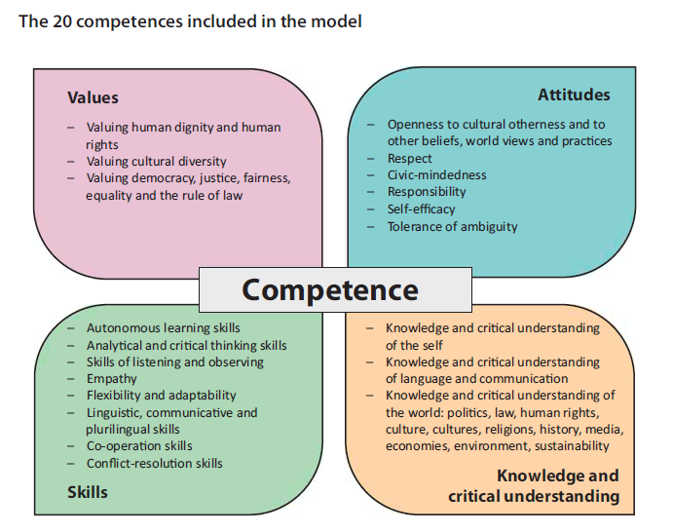
A MODEL WITH 20 COMPETENCES FOR DEMOCRATIC CULTURE

Slide 7
Our moment in history
Modern Europe is the result of a lot of effort, patience and determination of several generations.
Today we can see signs of tiredness, disappointment, skepticism and mistrust.
There are voices which call for division, exclusion, intolerance, individualism and shelfishness.
For the first time in history, a member state has left the Union.
CHALLENGE: make prevail the values of democracy, freedom, tolerance, solidarity, understanding, sustainability, coexistence, peace, acceptance and hospitality.

Slide 8
How to face this challenge
Educating for democratic citizenship by
using multidisciplinary approaches;
combining the acquisition of knowledge, skills and attitudes, particularly the capacity for reflection and the self-critical disposition necessary for life in culturally diverse societies;
underlining the particular importance of HISTORY TEACHING:
contributing to the elimination of prejudice and stereotypes,
highlighting positive mutual influences between different countries, religions and schools of thought,
studying critically misuses of history: denials of historical facts, falsifications, omissions, ignorance or re-appropriation to ideological ends,
proposing positive models (the actors of the construction of the EU) and the knowledge of the challenges, goals and ambitions of the EU.

Slide 9
PROPOSALS of the spanish presidency
Reinforcing the presence of the civic competence, with special reference to the European dimension, in the SYLLABI and in the organization of studies of the ES.
Introducing the European dimension and civic competence as a core part of the cross curricular project to be developed by students in the S6/S7 cycle.
Enhancing the monitoring of the European dimension in the quality control of the ES, by means of the WSI and audits of AES.
Mandating existing WGs (‘Pedagogical Reform’ and ‘Task Force’ in cooperation with the ‘QA’ and ‘RDI’ ) to:
DEVELOP these proposals,
DESIGN an action plan, in cooperation with the OSG, on the human resources needed to assist the Board of Inspectors and the Pedagogical Unit in their tasks and responsibilitites.

Slide 10
1. Reinforcing the presence of the civic competence in the SYLLABI and in the organization of studies of the ES
HOW?
Fostering the European dimension in the European hours in Primary
Making the European dimension a compulsory element in the structure of Secondary syllabi (2019-09-D-27)
Two possibilities:
a) Cross-curricular approach in all syllabi (specially in some subjects like History, Geography, Ethics…)
b) Introduction of a (complementary) course with a specific syllabus

Slide 11
2. Introducing the European dimension and civic competence as a core part of the cross curricular project to be developed by students in the S6/S7 cycle
HOW?
The Cross Curricular Project (included in the priorities of the Spanish presidency)
The work done by the WG ‘Assessment Secondary’
The introduction of the European dimension in the CCP and in its syllabus as a compulsory element

Slide 12
3. Enhancing the monitoring of the European dimension in the quality assurance of the ES
HOW?
By means of the WSI and audits of the AES
WSI (2010-D-139-en-9) includes a section about School Ethos and Climate with a criterion (II.1) related to this sphere and 3 indicators.
PROPOSAL:
a) Change the first bullet to: “The totality of the European dimension is explicitly integrated in teachers’ planning and is fully implemented across the school”.
b) Add a new criterion (II.5): “Civic competence is encouraged and developed trough a multidisciplinary/cross-curricular approach”.

Slide 13
4. PROPOSAL: Give a mandate to existing Working Groups
‘Pedagogical Reform’, ‘Task Force’ and ‘Quality Assurance’, in cooperation with the OSG and the ‘Roles and Duties of the Inspectors’
To develop the PROPOSALS regarding the enhancing of civic competence and European dimensión
To design an ACTION PLAN with a view to analysing the human resources needed to best assist the Board of Inspectors and Pedagogical Unit in their tasks and responsibilities

Slide 14
Thank you for your attention ¡gracias por su atención!

